Slide 1
Correlation between updraft strength and tornado intensity using Gibson Ridge Level 2 Analyst Edition software
Justin Schultz¹
Mentors: Karl Jungbluth² and Dr. Mike Chen¹
Department of Geological and Atmospheric Sciences
Iowa State University¹
Johnston, Iowa: National Weather Service²

Slide 2
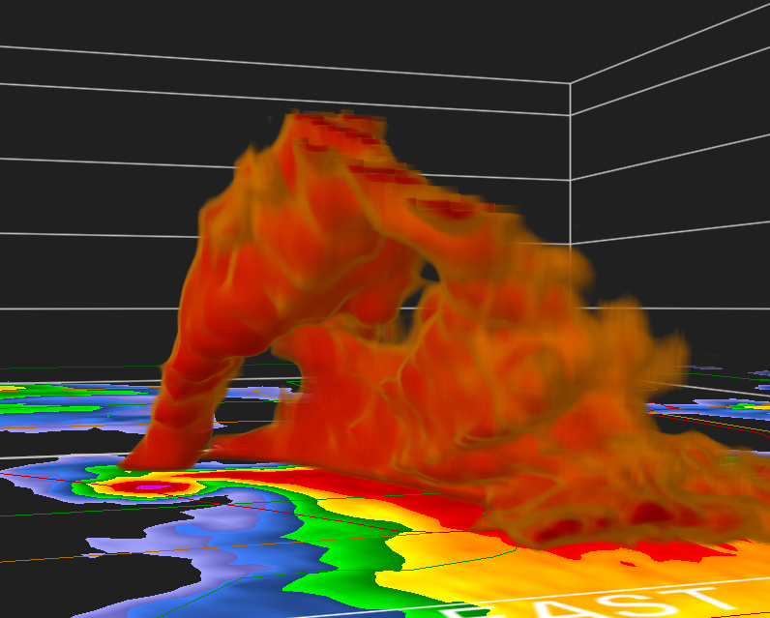
Background
Updraft importance
Gibson Ridge Level 2
Parameters observed
Purpose:
Correlation in GR2AE parameters to imply the strength of the updraft in tornadic supercells and observe how they vary by the F/EF Scale (combined by number; e.g. F3/EF3)

Slide 3
Hypothesis
I predict an increasing trend in the parameters as tornado intensity increases
50 dBZ Height, Echo Top Height, VIL and VILD
Updraft dependent parameters

Slide 4
Importance of the updraft
Why is it important?
Helps to drive the severe thunderstorm
Fuels it with warm, moist low-level air
Crucial in understanding thunderstorm kinematics and dynamics

Slide 5
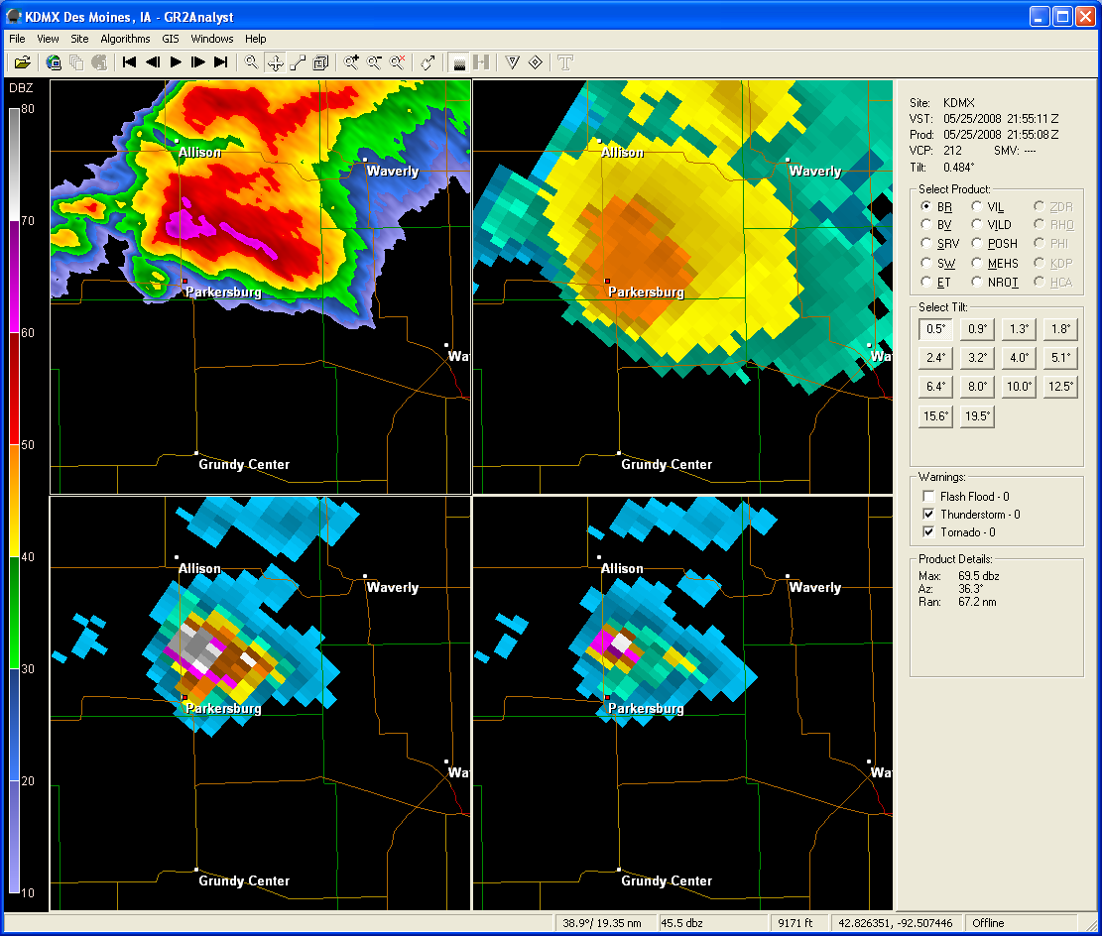
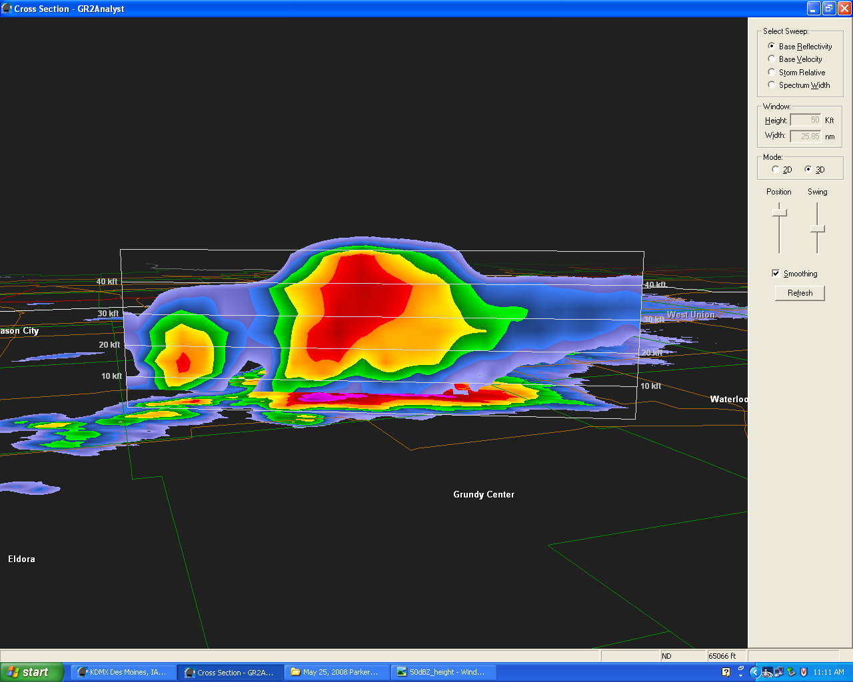
Gibson Ridge Level 2 Analyst
Used to observe WSR-88D Level 2 radar data
Many parameters can be observed

Slide 6
Parameters observed
50 dBZ Height: the highest extent of the 50 dBZ isosurface in the mesocyclone
Echo Top Height: the highest extent of the lowest values of reflectivity the radar can distinguish
Vertically Integrated Liquid (VIL): summation of reflectivity within a column of air
Vertically Integrated Liquid Density (VILD): normalized VIL
VILD = VIL/Echo Top Height

Slide 7
Methodology
Data includes mostly Midwest tornado cases of varying intensity
From May 1995 to July 2008
25 cases from each category (F0/EF0, F1/EF1,…,F4/EF4/F5/EF5), and a null case (NT— “No Tornadoes”)

Slide 8
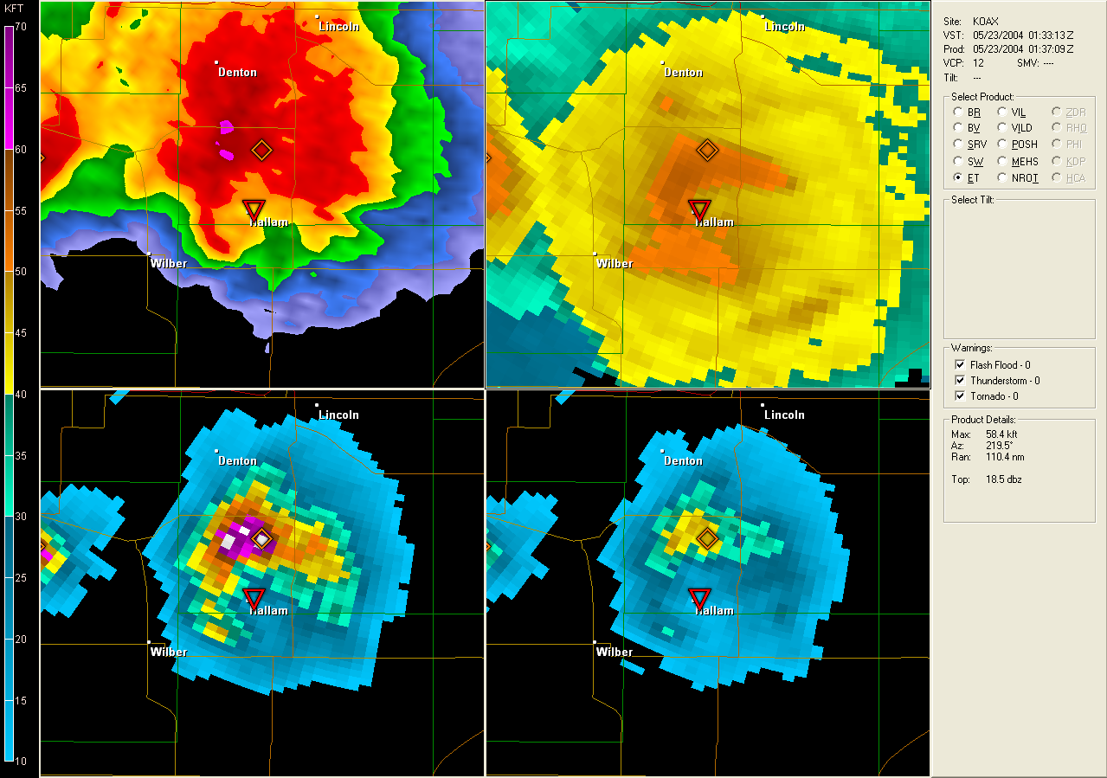
Methodology (continued)
Data was taken at the time of the tornado event (e.g. F4 at Hallam, NE at 0133 UTC)

Slide 9
Data
MEANS
Categories | 50 dBZ Height (meters) | Echo Top Height (meters) | VIL (kg/m²) | VILD (kg/m³)
NT | 7466.9 | 12,206.6 | 43.65 | 4.29
F0/EF0 | 8855.9 | 13,689.2 | 53.89 | 4.25
F1/EF1 | 7963.9 | 13,146.6 | 53.38 | 5.08
F2/EF2 | 9255.2 | 13,503.9 | 64.24 | 6.0
F3/EF3 | 10,721.2 | 14,523.1 | 71.81 | 6.09
F4/EF4 and F5/EF5 | 10,703.9 | 14,729.2 | 65.02 | 5.27

Slide 10
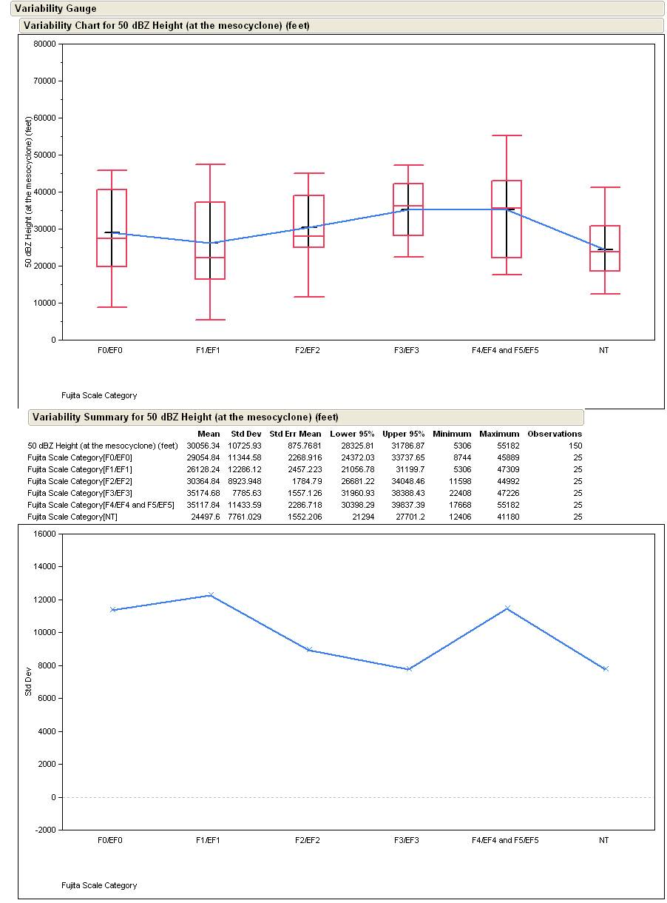
Data
50 dBZ Height—data was plotted using JMP

Slide 11
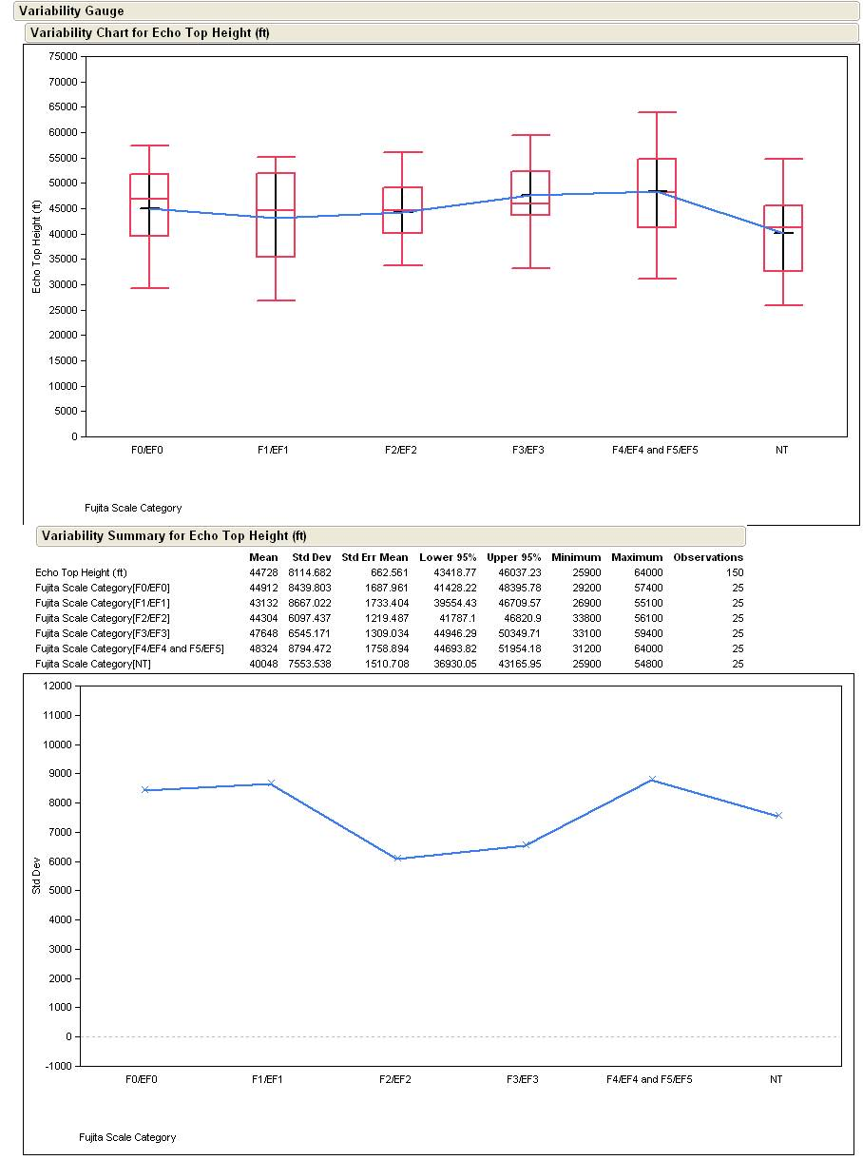
Data (continued)
Echo Top Height

Slide 12
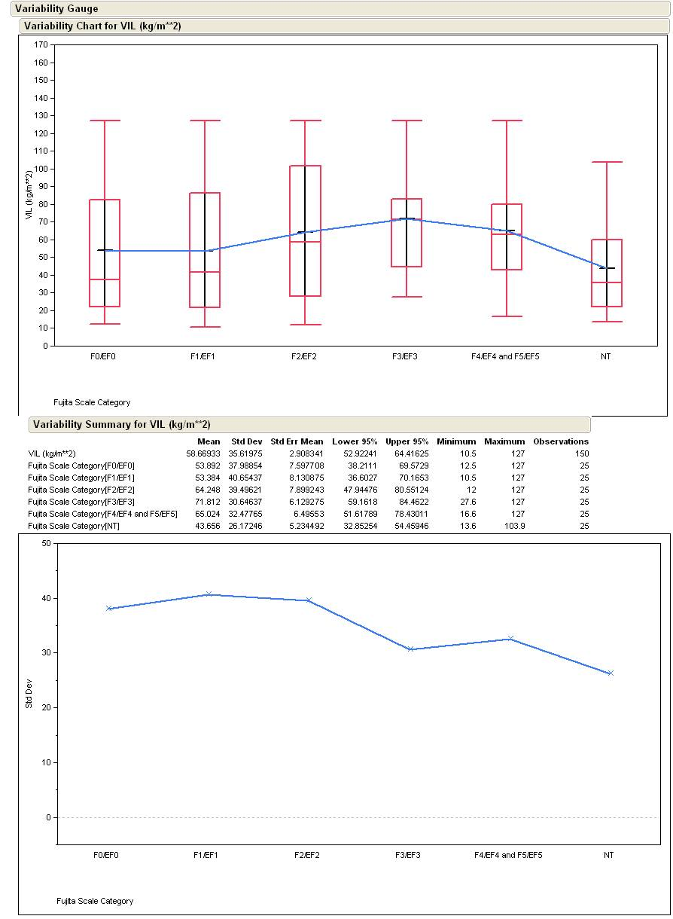
Data (continued)
VIL

Slide 13
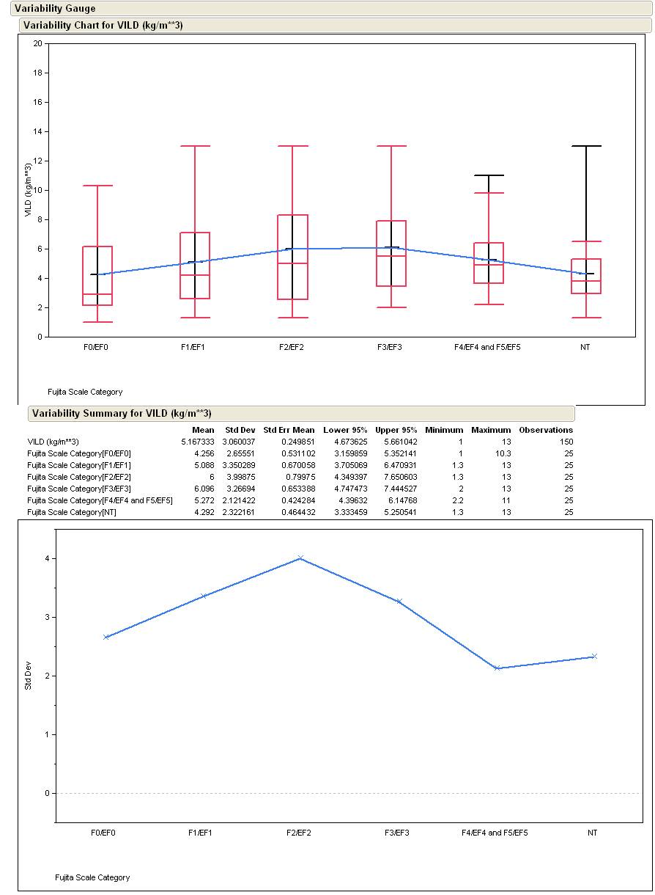
Data (continued)
VILD

Slide 14
Conclusions
A correlation in the mean trends.
Slight decrease from F0/EF0 to F1/EF1
Visible increase from F1/EF1 to F3/EF3
Trend levels off afterwards
Null cases show the lowest means
Data does not show a single trend for the whole gamut
Evidence of an increasing trend in the means as tornado intensity increases.

Slide 15
Further Research
Use of Base Velocity to create the 2-D wind vector field to use the kinematic method and divergence to make the updraft strength more quantifiable
Understanding the decreasing trends in the means

Slide 16
Acknowledgements
Karl Jungbluth and Dr. Mike Chen for their expertise in radar and dynamics
William S. Lincoln for helping me to locate Level 2 data
Dr. William Gallus for his help with the thesis paper and guidance of the research

Slide 17
References
Amburn, S. A., and Wolf, P. L., 1997: VIL Density as a Hail Indicator. Wea. And Fore., 12, 473-478
Boudevillian, B., and Andrieu, H., 2003: Assessment of Vertically Integrated Liquid (VIL) Water Content Radar Measurement. Jour. Of Atmos. And Ocean. Tech., 20, 807-819
Browning, K. A., 1965: Some Inferences About the Updraft Within a Severe Local Storm. J. Atmos. Sci., 22, 659-667
Greene, D. R., and Clark, R. A., 1972: Vertically Integrated Liquid Water—A New Analysis Tool. Mon. Wea. Rev., 100, 548-552
Haby, Jeff, cited 2008: What is VIL (Vertically Integrated Liquid)?
[Available online at http://www.theweatherprediction.com/habyhints/249/]
Haby, Jeff, cited 2008: What are Echo Tops and their Importance?
[Available online at http://www.theweatherprediction.com/habyhints2/382]
Marwitz, J. D., 1972: Locating the Organized Updraft on Severe Thunderstorms. J. Appl. Meteor., 11, 236-238
Matejka, T., and Bartels, D. L., 1998: The Accuracy of Vertical Air Velocities from Doppler Radar Data. Mon. Wea. Rev., 126, 92-117

Slide 18
Questions? Comments?
Justin T. Schultz
jsch78@iastate.edu
Thank you very much!

